Slide 1
Image Colorization
Colorizing Old Grayscale Images using Deep Learning Frameworks

Slide 2
Introduction
Various grayscale photos were taken decades ago, and there is a need for professional artists to colorize these images.
However, manual approaches are both labor-intensive and time-consuming.
The objective of image colorization problem is to construct a colorized photorealistic image from a grayscale photograph without user supervision.
Given a grayscale image of height h and width w, we must construct a colorized version of the image.

Slide 3
Dataset
In general, a dataset is constructed from a set of inputs (X) and a set of expected outputs (Y).
A grayscale image will be the input for this task, and a colorized version will be the expected output.
We used the Flickr8k dataset, which contains 8,091 color photos.
We convert them into grayscale images to get the corresponding set of inputs.

Slide 4
Color to Grayscale
In the RGB encoding, an image is represented as a combination of three primary colors, namely Red, Green, and Blue.
A picture in this format is represented as a 3D matrix whose dimensions are h x w x 3.
RGB images can be converted to grayscale images by taking their weighted sum, i.e.,
Grayscale = w1*Red + w2*Blue + w3*Green
Where [w1, w2, w3] = [0.299, 0.587, 0.114]

Slide 5
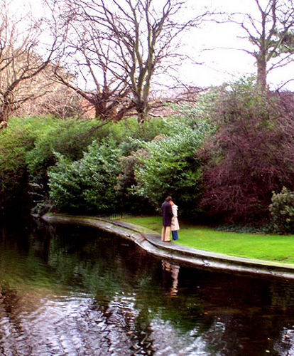
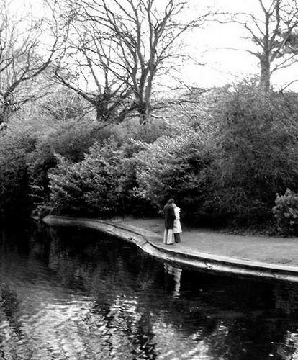
Color to Grayscale

Slide 6
Problem Definition
First, we represent an image in the LAB color space
L corresponds to the lightness channel (0 black, 100 white)
A corresponds to the combination of green(-) and red(+)
B corresponds to the combination of blue(-) and yellow(+)
Given the image’s L values (similar to grayscale, but scaled from 0 to 100 instead of 0 to 255), we try to predict the corresponding A and B values
Given a grayscale image I represented using the lightness channel L, we must predict the corresponding A and B values to generate a coloured image represented as I’ = [L, A, B]

Slide 7
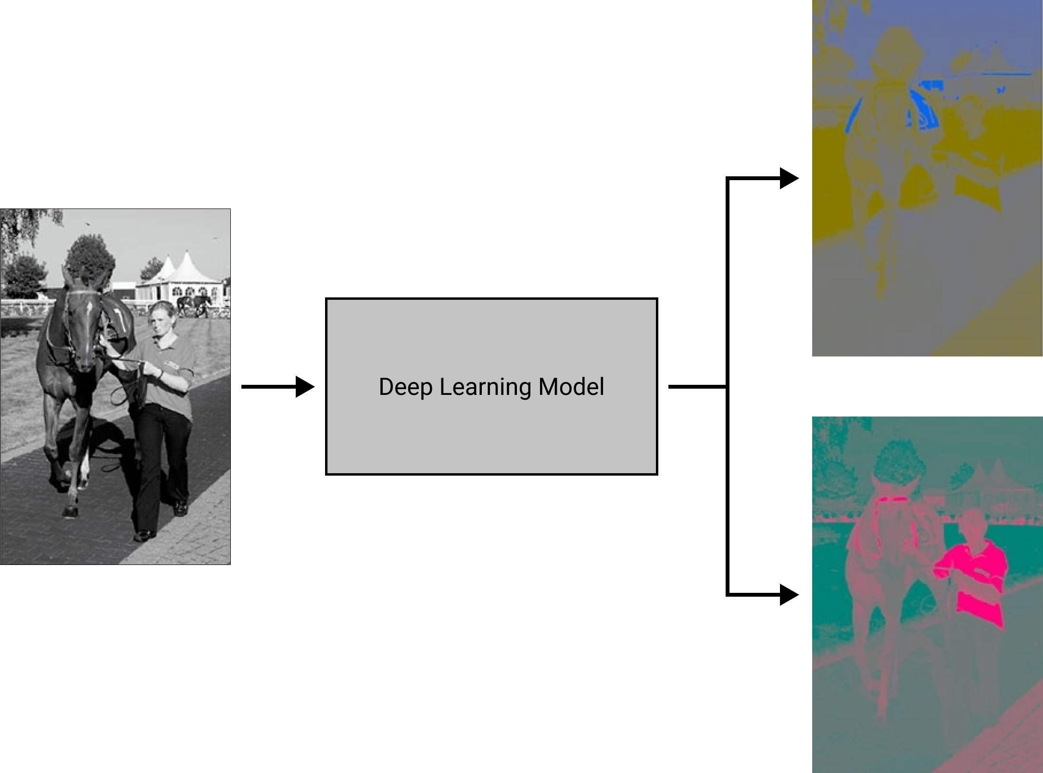
Problem Definition

Slide 8
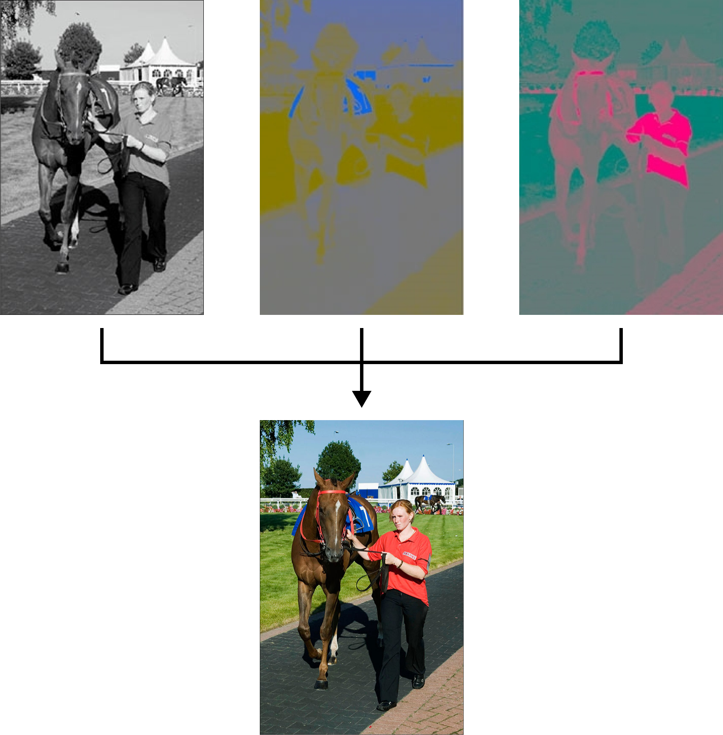
Problem Definition

Slide 9
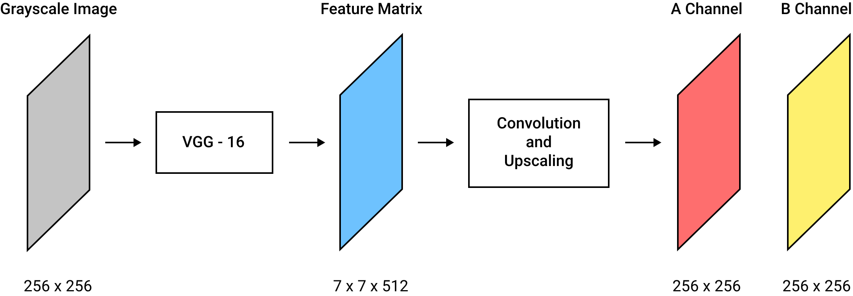
Model Architecture

Slide 10
Model Architecture
We have used VGG-16 to extract image features
This is followed by a convolution and upscaling network, to generate the values for A, B channels.
This network consists of a series of Conv2d and Upscaling2d layers
We have used Adam optimizer, and Mean Squared Error loss function

Slide 11
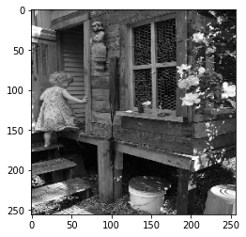
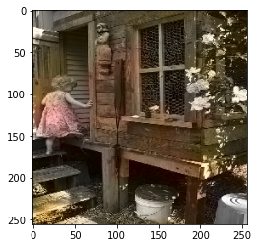
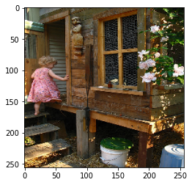
Predictions
Grayscale
Prediction
Actual

Slide 12
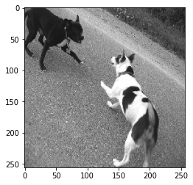
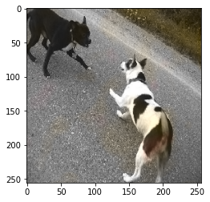
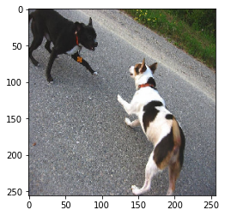
Predictions
Grayscale
Prediction
Actual

Slide 13
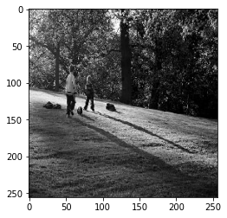
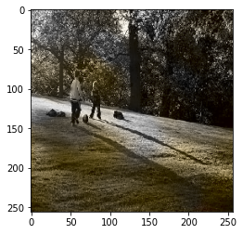
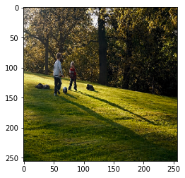
Predictions
Grayscale
Prediction
Actual

Slide 14
Inference
The model has generalized the color of grass to grey-green.
Even though the colorization seems plausible, it is not able to pay attention to more minor details in the image
Colors are smudged
Colorization is incomplete
During training, the overall loss plateaued just after 10 epochs. This suggests that the model is not able to learn the features accurately

Slide 15
Future Work
Change the model’s architecture (add additional layers and explore other colorization techniques)
Change the model’s loss function (As seen in colorful image colorization paper)
Use Resnet and Inception network to extract image-based features
Train our model on other image-based datasets like ImageNet and MS COCO

